Slide 1
CND111: Introduction to Digital Design

Slide 2
Lab 6: Sequence Detector

Slide 3
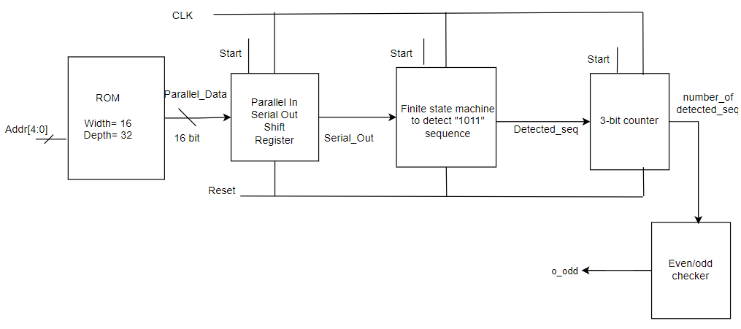
Objective
This lab will implement a sequence detector for the non-overlapping bit stream of “1011”.

Slide 4
Specification
A 16-bit word will be read from a 16x32 ROM.
A Parallel-in-serial-out (PISO) block will load the 16-bit word from the ROM in a register and output a single bit every clock cycle.
An FSM will detect if the sequence “1011” is received
A counter will count how many “1011” sequences are there in a 16-bit word.
An even/odd checker block will output 1 if the number of sequences is odd and will output 0 if it is even.

Slide 5
How to create you own symbols and block diagram
In Quartus software, you can create your own symbols from HDL design entities.
To create a block design file from a Verilog HDL design file, click File > Create/Update, and click Create Symbol Files for Current File.
To create a new schematic file (*.bdf) in Quartus, point to File > New and select the Block Diagram/Schematic File.
To insert block symbols into the schematic, double-click the schematic file and choose the appropriate block symbols.

Slide 6
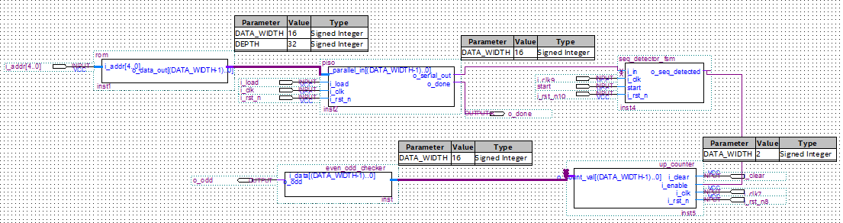
How to create you own symbols and block diagram

Slide 7
Requirements
Write Verilog Code for each module
Create the top-level design using Quartus’s block diagram tool.
Design a testbench for the top level and test the design

